Slide 2
Authentication at Google
Local/End user
Hosting (Onpremise/GCP)
User
Auhenticate case
Authenticate application users
Auhenticate case
Setup ADC
Then use Cloud Client Libraries
My Application
Cloud Services
Cloud Run or Cloud Functions
Auhenticate case
Get OpenID Connect token
Provide it with request
My Application
Gcloud CLI
https://cloud.google.com/docs/authentication
Notes:
https://cloud.google.com/docs/authentication/use-cases#google-apis

Slide 3
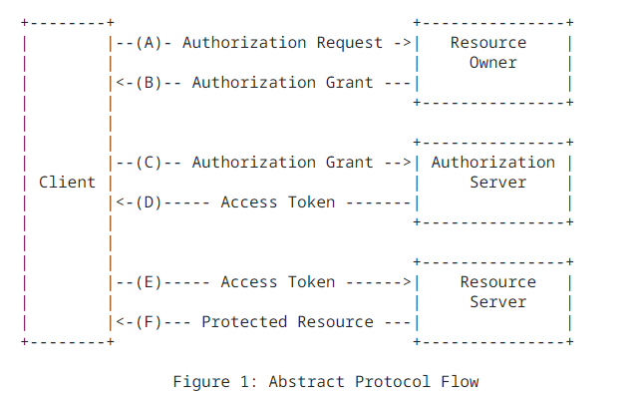
OAuth 2.0 Introduction
Authorization Code (user-agent defined)
https://datatracker.ietf.org/doc/html/rfc6749#page-4
Notes:
https://cloud.google.com/docs/authentication/use-cases#google-apis

Slide 4
OAuth 2.0 Introduction
Authorization Code (user-agent defined)
https://datatracker.ietf.org/doc/html/rfc6749#page-4
Notes:
https://cloud.google.com/docs/authentication/use-cases#google-apis

